Slide 1

DS - 510 FINAL PROJECT
Impact of a number of automobile engine factors on the vehicle’s mpg
Ankita Ashok Jethva - 1028996
Venkatesh Shamala -1031744

Slide 2
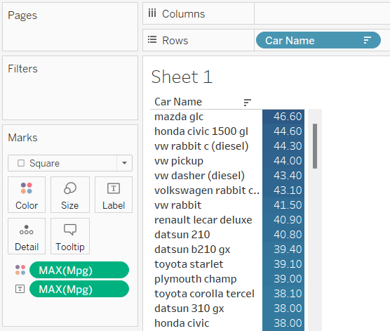
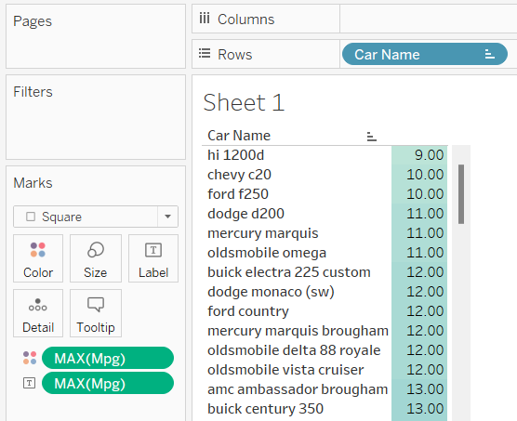
Maximum and Minimum MPG
Mazda glc has the maximum mpg value among all cars which is about 46.60 miles per gallon of fuel
Hi 1200d has the minimum mpg value among all cars which is about 9 miles per gallon

Slide 3
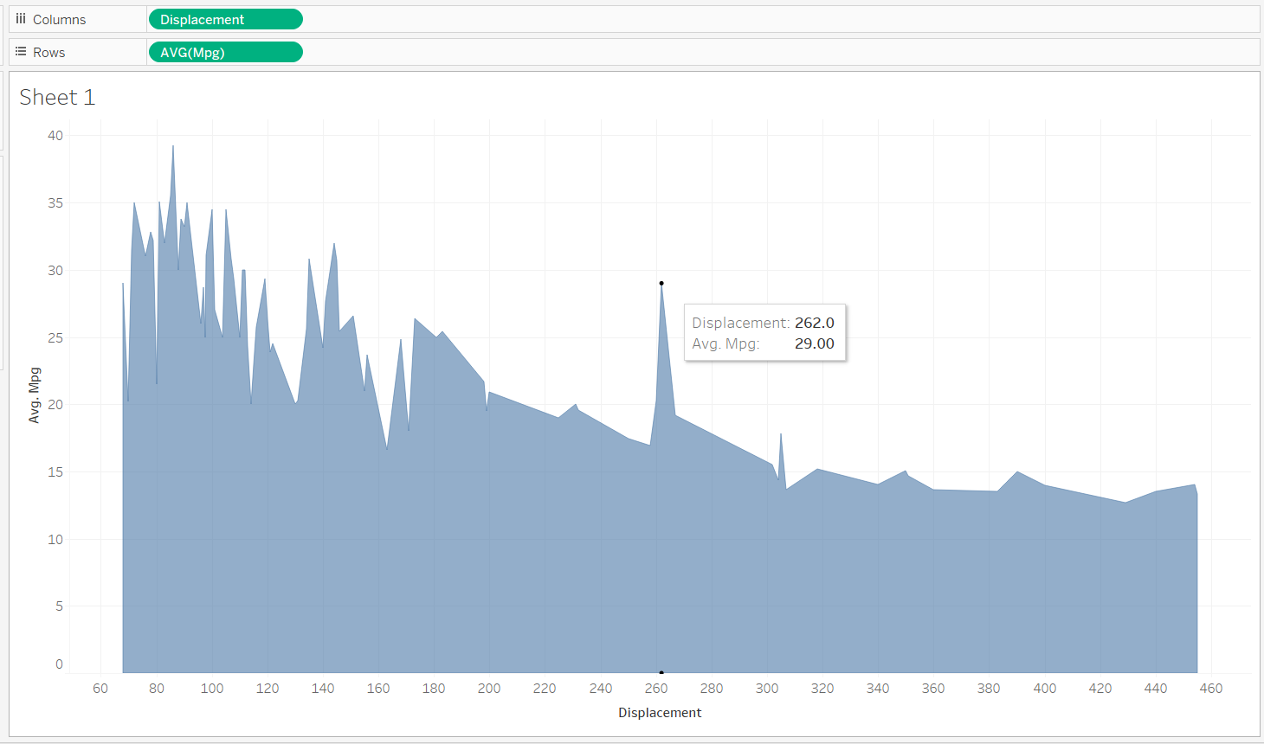
Displacement vs MPG
Displacement of the engine is inversely proportion to fuel economy. More the displacement more is the power and less is the efficiency. In high displacement engine the fuel required is more for engine to work so MPG is less.

Slide 4
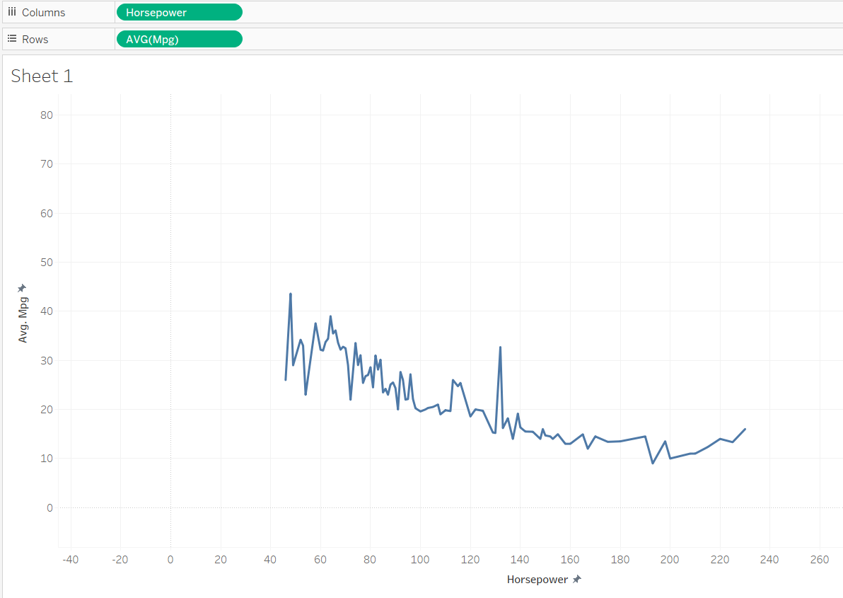
Horse Power vs MPG
Horsepower is a major factor in a vehicle's fuel consumption. More power generally means higher fuel consumption. This means you can save money on fuel, and reduce your impact on the environment, by choosing a vehicle with no more horsepower than you need

Slide 5
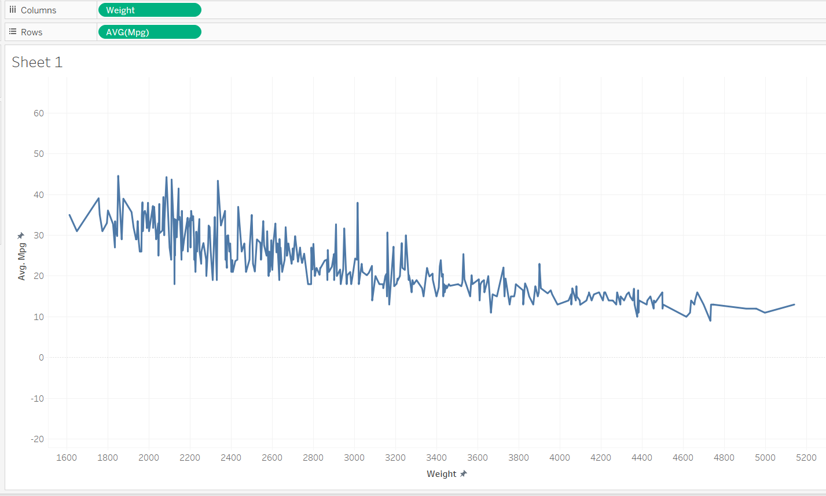
Weight vs MPG
This indicates that the lighter the car is, the higher or better, gas mileage it gets. So, the heavier the car, the worse the gas mileage it is.

Slide 6
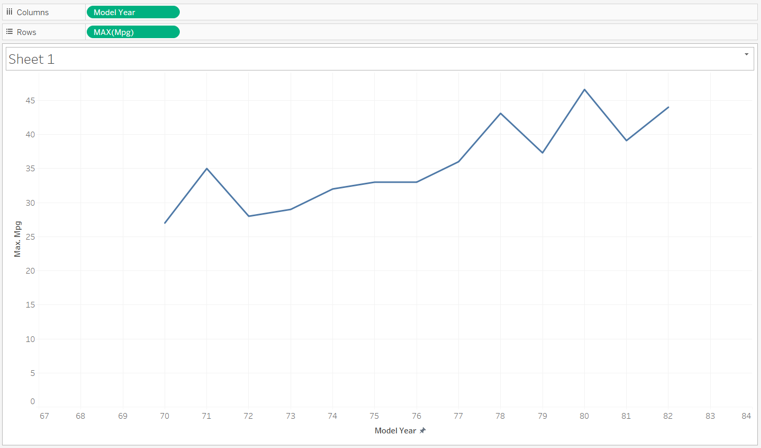
Model year vs MPG
This Graph shows that Automobile companies consistently prioritize the enhancement of fuel efficiency in their vehicles as a strategic goal

Slide 7
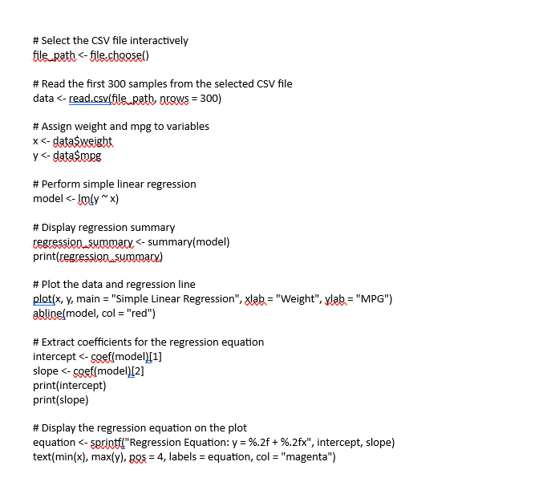
Simple Linear Regression Code

Slide 8
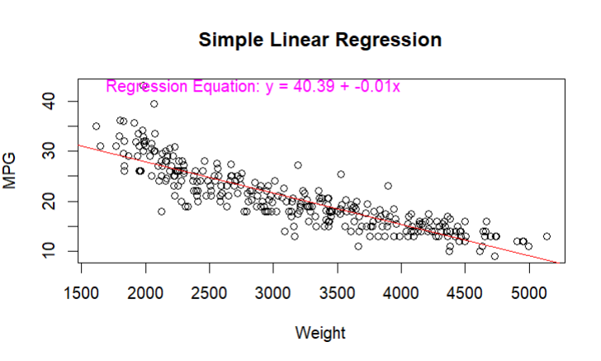
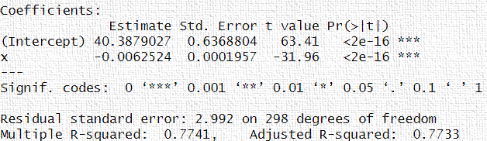
Simple Linear Regression

Slide 9
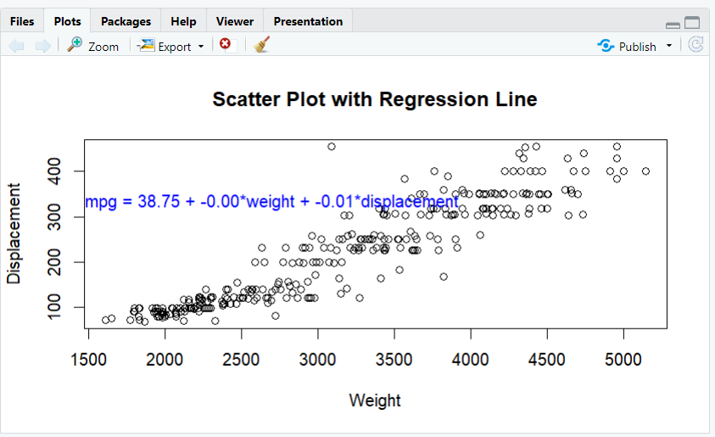
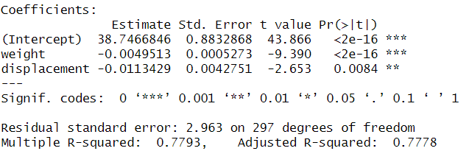
Multiple Linear Regression

Slide 10
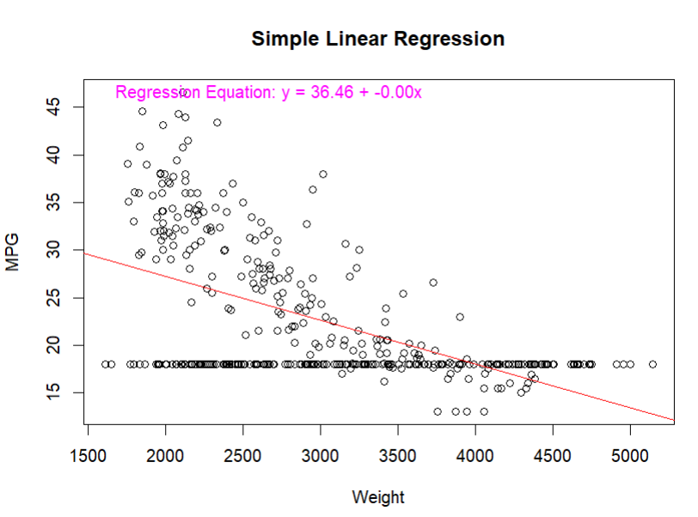
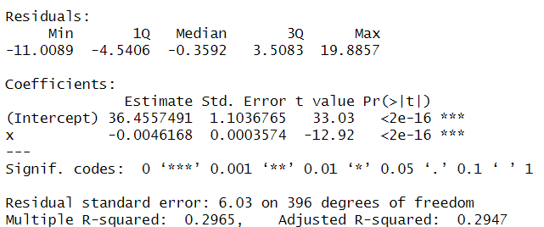
Simple Linear Regression for 98 samples

Slide 11
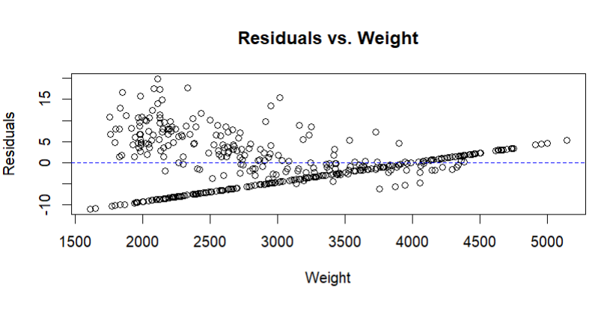
Residual Plot

Slide 12
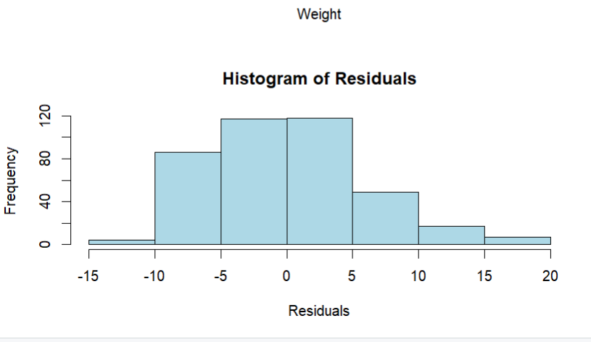
Histogram

Slide 13
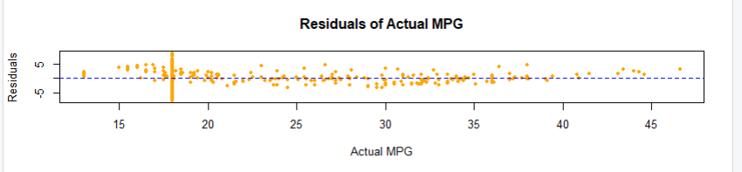
Residual plot showing Actual MPG vs Predicted MPG

